Slide 1
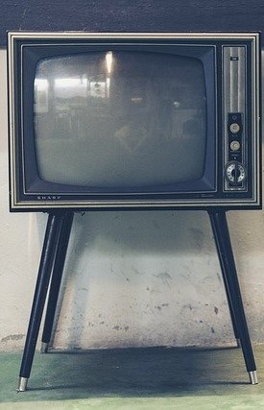
LECTURE FOUR: TV STANDARDS
ET 8105 – Television Systems

Slide 2
Introduction
Television standards consist of a set of specifications for transmission of TV programmes
These specifications pertain to the scanning process, colour encoding system, composite video signal, modulation methods, bandwidth, inter carrier frequency, channel width and radio frequency spectrum utilisation.

Slide 3
Need for a TV Standard
A TV receiver cannot receive TV programmes unless it conforms to the specifications adopted for transmission.
For example, a TV receiver needs scanning identical and synchronised to the scanning process that was used in the transmitter.
Similarly for detection of colour signals, the same subcarrier is required to be generated in the receiver as was employed in the transmitter.
Different countries adopted different standards.
Hence, the receivers in a country are designed to receive TV transmissions of the specifications followed by that country.

Slide 4
Even a minor difference in the transmitter specifications of a country may not allow receivers of some other country to receive TV programmes of that country.
Because of the, the TV signals have to be specified exactly and hence the need of TV standards.

Slide 5
REASONS OF TV STANDARDS BEING DIFFERENT IN DIFFERENT COUNTRIES
The different standards of TV transmission are not compatible with each other.
No American set can work in Europe and vice versa.
Non-compatibility of various standards is the biggest hurdle in international exchange of programmes.
A single world standard of TV would have been desirable.
The need for a single world standard for TV is being felt all the more due to the development of satellite communication.
Hence there must be some compelling reasons for TV standards being different in different countries

Slide 6
These reasons are as highlighted below:
Fields frequency in the scanning process is related to the electric mains frequency. Thus differences in mains frequency leads to differences in scanning frequency. E.g. American countries – 60 Hz, Asia, Europe, Australia and Africa – 50 Hz.
Fields frequency is also related to brightness. Higher field frequency means greater brightness, larger viewing distance and smaller can be the number of scanning lines per frame. 60 Hz = 525 lines per frame, 50 Hz = 625 lines per frame.
USA, Germany and France developed different colour encoding and decoding systems, known as NTSC, PAL and SECAM respectively. On account of merits and demerits of these systems and considering the existing monochrome system, countries all over the world chose one of these three systems.

Slide 7
Some countries preferred minor changes in channel width, bandwidth, inter-carrier frequency, etc. for various reasons such as, improving picture quality, and for political reasons. TV system of UK is an example of this.

Slide 8
Different TV Standards
In view of several existing standards, the Committee Consultative for International Radio (CCIR) could not decide on a single world standard, but listed some existing standards leaving the choice to the countries to choose any of them.
TV systems standardized by CCIR are designated as A, B, C, D, E, F, G, H, I, K, L, M and N.
Out of the above designated systems, A, C, E and F have not been recommended for future use.
G, H, I, K and L systems are used in UHF bands IV and V.
M and N systems are used in VHF and UHF both.
B and D systems are used in VHF bands I and III.

Slide 9
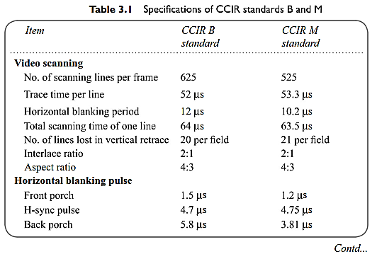

Slide 10
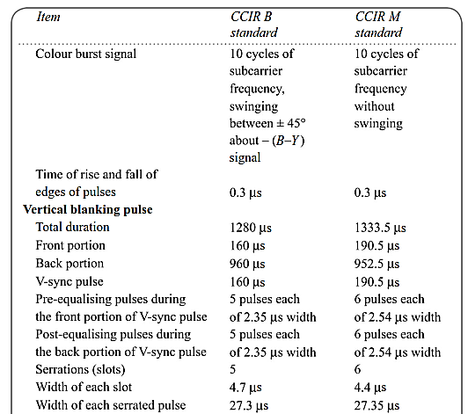

Slide 11
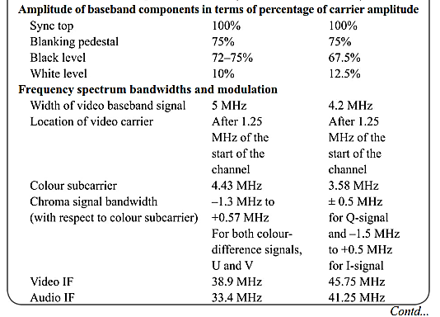

Slide 12
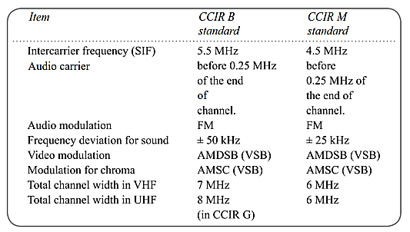

Slide 13
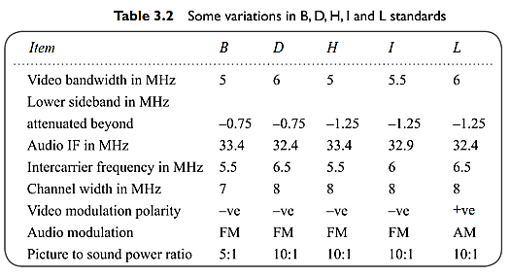

Slide 14
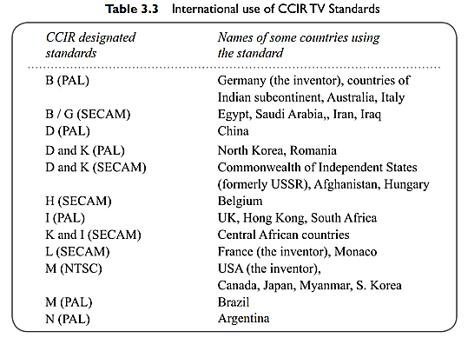

Slide 15
Modern Trends
The scenario in TV transmission is changing drastically.
VHF band is being abandoned and being replaced by UHF band
Analog system have been phased out and digital ones with high definition are taking over.
Wider screens, using LCDs or plasma are being preferred to small screens.
TO standardize modern systems, NTSC has been replaced by ATSC (The Advanced Television Systems Committee) by Federal Communications Commission of USA.

